Slide 1

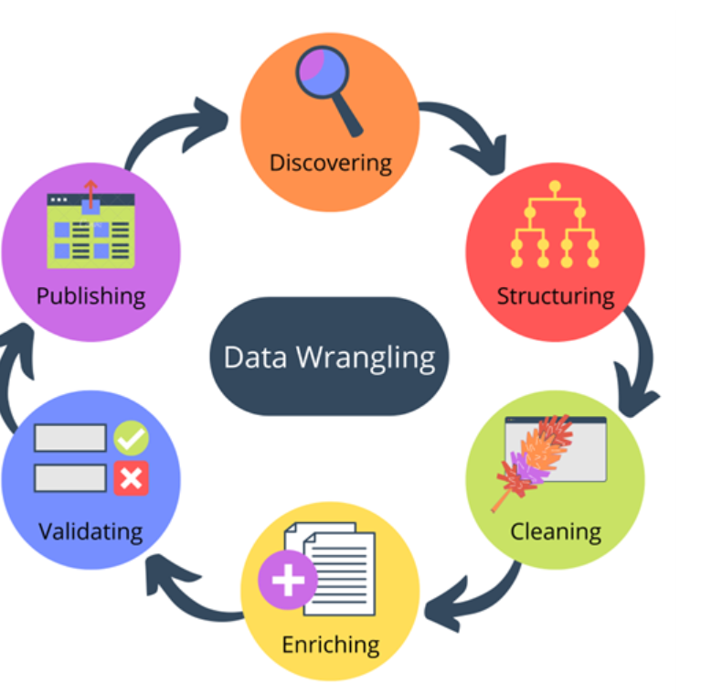
DATA WRANGLING
Anshul Chanana

Slide 2
What is Data Wrangling?
Data Wrangling also known as data cleaning or data remediation → refers to the variety of processes designed to transform raw data into readily used format . The process varies from project to project depending on the expected outcome.
Examples → 1) Data Merging
2) Deleting unnecessary data
3) Identifying and managing Outliers.
4) Handling and adjusting null values for accuracy.

Slide 3
Data Wrangling Steps
For every code , the steps are different as it depends on the type of raw data and the final outcome that we are looking on . In our code, following steps are being used.
Steps → 1) Data Merging – Merged dataset 1 and 2.
2) Structuring
3) Merging with dataset 3 .
4) Finding unique.
4) Finding outliers.
5) Finding correlation.
6) producing and visualising for analysis.
Few steps are mentioned ahead with some Insights.

Slide 4
Step - 1 Merging
We have merged dataset 1 and dataset to have a concise view .
After merging the shape and data types of the data Frame were checked.
To merge the dataset , I used left join as I wanted to keep the dataset 1 and take out the matching data from 2..
(“df3 = pd.merge(df1,df2 , how='left', on =['instant'])

Slide 5
Step - 2 Data Cleaning
Isnull.sum function is used to find the null values in the merged data frame.
Null values are being incorporated with its mean to remove Nan’s.
We could also remove the NAN rows but it wasn't done as it was affecting the result.
For further steps please refer the jupyter notebook.
Link → Jupyter Notebook

Slide 6
Data wrangling Tools
There are different tools that can be used for data manipulation , data cleaning , structuring etc before putting it for analyzation or BI tools. Many automated tools can be for data cleaning activities .
I have used Python for the process. Two main libraries are used over here i.e., Pandas and Numpy.
For data visualization seaborn has been used.
Link → Jupyter Notebook

Slide 7
Importance of Data Wrangling
Any analysis that a business does will be controlled by the data . If the data is incorrect or not properly managed may lead to wrong insights.
Data wrangling is done to remove the above risk making sure that the data is reliable before it is analysed or leveraged.
Data wrangling is a time consuming process that needs attention. Follow the below link to look the project.
Link → Jupyter Notebook

Slide 8
Benefits of Data Wrangling
Data Wrangling helps to improve data usability as it converts data into a compatible format for the end system.
It helps to build data flows within an intuitive user interface and easily schedule the data flow.
Integrates various types of information and their sources like databases , files etc.
Help user to process very large volumes of data easily .

